Slide 1
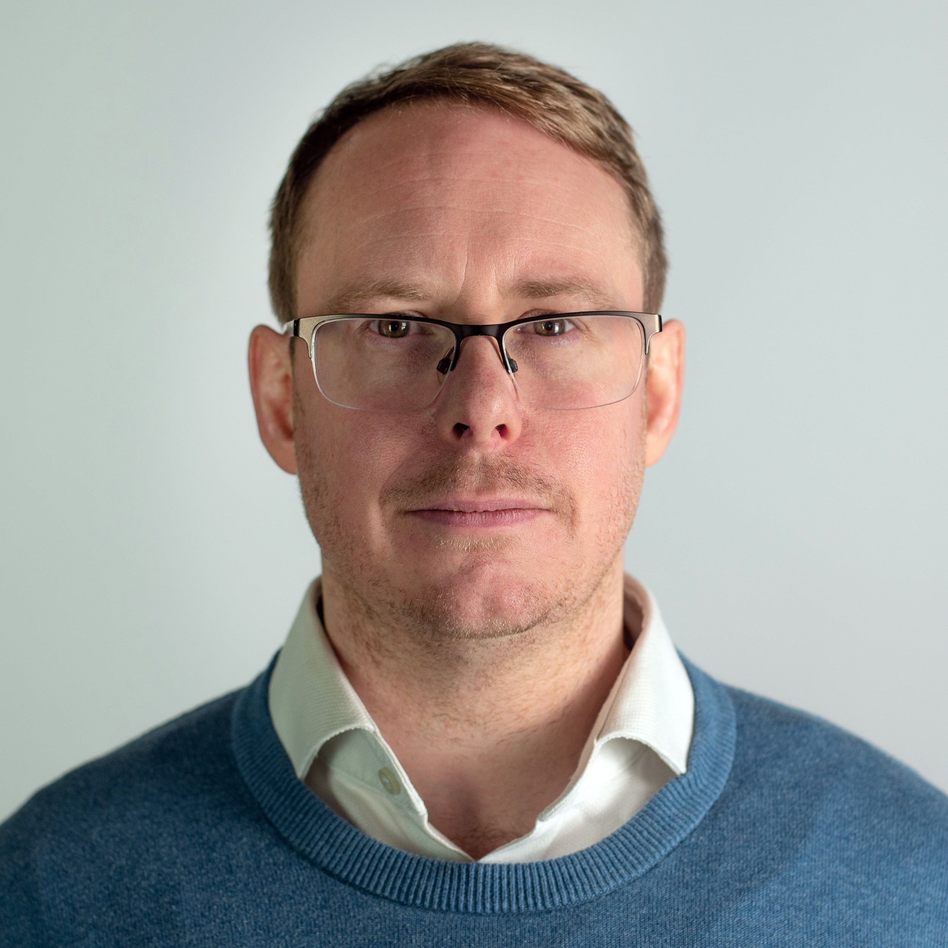
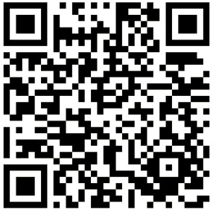
Tools are not the answer: The role of Leadership and Change in DevSecOps
Introducing LRQA, a leading global assurance partner.
Sebastian Coles
Head of AppSec & DevOps @ LRQA
18th April 2024
Sebastian.coles@lrqa.com
https://uk.linkedin.com/in/sebastiancoles

Slide 2

Roadmaps and Planning for Change
People First
6. Short Term Wins
Measure Engagement
Kotters 8 Steps
Automatic Metric SAST, SCA, IaC Scanning, CSPM selection and implementation
WAFs and Secure Key Shared Services
SDLC Policies Refresh and launching new security principals
1. Urgency
Posture
Security Maturity Model BSIMM, SAMM, NIST SDF, SALSA – I like BSIMM
Developer Security Education so you can build common language
Threat Modelling to allow frequent touch points
202X
202X+1
202X+2
Develop a Roadmap Showing nirvana and the destination
Security Chapters providing a network, development ground, feedback, fans, resourcing, market insights
Succession Planning and being generous with responsibilities
Change
Secondments and Rotations to help share knowledge and working practises
3. Vision
2. Coalition
5. Empower
8. Make it Stick
Gamification promote the teams who are doing well and help that teams that are struggling
Establishing Front Door and Onboarding being accessible and training the next 10%
4. Communicate
7. Don’t Let Up
Frequently Present and the all-hand platforms
Kotter, J., 1999. What Leaders Really Do, 1st Edition, Harvard Business School, 1999

Slide 3









Understand what game you're playing
Businesses are usually dominated by success games, they don’t need to be
Success Games
Competing to win
Reporting and Metrics
Demonstrating the world Is getting better and ROI
Gamification
Rewarding and recognising teams who are performing the best
Virtue Games
Good, Moral, Righteous
Dominance Games
Force, Fear, Control
Security Champions
Part of something more, something special, different
Value Proposition
To be more trusted in the market
Protecting Customers
Doing the right thing, our responsibility
Protecting Family
What if the customer could be your family and friends?
…play to the hero narrative
Storr, W. (2021). The Status Game: On Social Position and How We use It. William Collins.

Slide 4






Influence, Politics and the Force
You must cultivate and harness the power of the social fabric in your organisation, and help your team overcome self-limiting beliefs to harness it too.
Key Players
High Power / High Interest – Must cultivate
Reframe Politics
Need to play the game
Irrelevant
Low Power / Low Interest – Minimise efforts
Sleeping Giants
High Power / Low Interest – Keep Satisfied
Gadflies
Low Power / High Interest – Keep Informed
Slack N., 2019 Operations Strategy, 6th Edition, Pearson, 2019

Slide 5





Intrapreneurship
Value Stream Mapping
Porters 5 Forces
Sales
Customers
DELL
EUC
Platform
Azure
Product
Engineering
Security Ops
Competitive Rivalry
Supplier Power
Buyer Power
Threat of Substitution
Threat of New Entrants
SecEng
Porter, M. E., 2008. The Five Competitive Forces That Shape Strategy. Harvard Business Review

Slide 6

Summary
Use the tools of change
Is not just about security tools
Be a source of status
Remarkable strong driver in tech communities
Cultivate the force
And encourage others to do the same
Grow organically
Find ways to leverage security to solve business problems

Slide 7
Navigate a new era of risk
Our portfolio of solutions enables our clients to:
Assure assets and management systems
Be cyber resilient
Achieve product integrity
DATA &
INSIGHT
Navigate the energy transition
and achieve net zero
Source responsibly
Solving critical business challenges
and enabling them to focus on growth

Slide 8
We are at Stand #N45!
Say hello and say I sent you ☺
Sebastian Coles
Head of AppSec & DevOps @ LRQA
18th April 2024
Sebastian.coles@lrqa.com
https://uk.linkedin.com/in/sebastiancoles

